Slide 1
SS ZG653 (RL 9.1): Software Architecture Introduction to Patterns
Instructor: Prof. SantonuSarkar

Slide 2
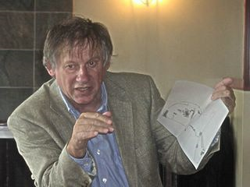
Christopher Alexander
The Timeless Way of Building is a 1979 book that ties life and architecture together
Much of SW Architecture derives from it
A Pattern Language: Towns, Buildings, Construction is a 1977 book on architecture
Source: http://en.wikipedia.org/wiki/Christopher_Alexander

Slide 3
What is a (Architecture) Pattern
A set of components (or subsystems), their responsibilities, interactions, and the way they collaborate
Constraints or rules that decide the interaction
To solve a recurring architectural problem in a generic way
Synonymous to architecture style
Buschmann, F. et al, Pattern Oriented Software Architecture – Volume1, Wiley, 1996

Slide 4
Properties of Patterns
Addresses a recurring design problem that arises in specific design situations and presents a solution to it
Document existing, well-proven design experience
Identify and Specify abstractions at the high(est) level
Provide a common vocabulary and understanding of design principles
Helps to build complex systems
Manage software complexity

Slide 5
A note on Design Principles
A set of guidelines that helps to get a good design
Robert Martin’s book on Agile Software Development says
Avoid Rigidity (hard to change)
Avoid Fragility (whenever I change it breaks)
Avoid Immobility (can’t be reused)

Slide 6
OO Design Principles
Open close
Open to extension and close for modification
Template and strategy pattern
Dependency inversion
Decouple two module dependencies (A→ B)
A holds the interface of B. Implementer of B implments the interface.
Adapter pattern
Liskov’s Substitution
Superclass can be replaced by subclass
Interface Segregation
Don’t pollute an interface. Define for a specific purpose
Single responsibility
One class only one task

Slide 7
Pattern – Three-part Schema
Pattern
Context A situation giving rise to a problem
Problem The recurring problem arising in that context
Solution A proven solution of the problem

Slide 8
Context
A scenario or situation where design problem arises
Describe situations in which the problem occurs
Ideally the scenario should be generic, but it may not always be possible
Give a list of all known situations
Example
Developing Messaging solution for mobile applications
Developing software for a Man Machine Interface
Context
Pattern
Problem
Solution

Slide 9
Problem
Starts with a generic problem statement; captures the central theme
Completed by forces; aspect of the problem that should be considered when solving it
It is a Requirement
It can be a Constraint
It can be a Desirable property
Forces complement or contradict
Example
Ease of modifying the User Interface (Personalization)
Context
Pattern
Problem
Solution

Slide 10
Solution
Configuration to balance forces
Structure with components and relationships
Run-time behavior
Structure: Addresses static part of the solution
Run-time: Behavior while running – addresses the dynamic part
Example
Building blocks for the application
Specific inputs events and their processing
Context
Pattern
Problem
Solution

Slide 11
Reference Model
Architecture Style/Pattern
Operational Platform and Infrastructure Pattern
Design Pattern
Idioms
Programming language level best practices
software-centric solution to implement the application logic, data and the interaction. The solutions include (but not limited to) package structure, analysis patterns for data modeling
GoF, Fowler’s analysis pattern
A topology of nodes where the functional blocks will be deployed at runtime
A topology of hardware devices
Multi-tier pattern, IBM runtime patterns, availability patterns
A set of components (or subsystems), their responsibilities, interactions, and the way they collaborate
address one or more quality concerns
An ideal solution for a domain, comprising of only functional elements without any technology or operational platform
NGOSS framework in Telecom
Open financial services architecture based on the use of intelligent mobile devices,” Electronic Commerce Research and Applications, 2008.
Abstract
Implementation

Slide 12
Pattern System
A pattern system for software architecture is a collection of patterns for software architecture, together with guidelines for their implementation, combination and practical use of software development

Slide 13
Pattern System
Support the development of high-quality software systems; Functional and non-functional requirements
It should comprise a sufficient base of patterns
It should describe all its patterns uniformly
It should expose the various relationships between patterns
It should organize its constituent patterns
It should support the construction of software systems
It should support its own evolution

Slide 14
Pattern Classification
It should be simple and easy to learn
It should consist of only a few classification criteria
Each classification criterion should reflect natural properties of patterns
It should provide a ‘roadmap’
The schema should be open to integration of new patterns

Slide 15
Problem Categories
Category | Description
Mud to Structure | Includes patterns that support suitable decomposition of an overall system task into cooperating subtasks
Distributed Systems | Includes patterns that provide infrastructures for systems that have components located in different processes or in several subsystems and components
Interactive Systems | Includes patterns that help to structure human-computer interaction
Adaptable Systems | Includes patterns that provide infrastructures for the extension and adaptation of application in response to evolving and changing functional requirements
Structural Decomposition | Includes patterns that support a suitable decomposition of subsystems and complex components into cooperating parts
Organization of Work | Includes patterns that define how components collaborate to provide a complex service

Slide 16
Problem Categories
Category | Description
Creation | Includes patterns that help with instantiating objects and recursive object structures
Service Variation | Comprises patterns that support changing the behavior of an object or component
Service Extension | Includes patterns that help to add new services to an object or object structure dynamically
Adaptation | Provides patterns that help with interface and data conversion
Access Control | Includes patterns that guard and control access to services or components
Management | Includes patterns for handling homogenous collections of objects, services and components in their entirety
Communication | Includes patterns that help organize communication between components
Resource handling | Includes patterns that help manage shared components and objects

Slide 17
Pattern Classification
 | Architectural Patterns | Design Patterns | Idioms
Mud to Structure | Layers, Pipes and Filters, Blackboard
Distributed Systems | Broker, Pipes and Filters, Microkernel
Interactive Systems | MVC, PAC
Adaptable Systems | Microkernel, Reflection
Creation |  | Abstract Factory, Prototype, Builder | Singleton, Factory Method
Structural Decomposition |  | Whole-Part, Composite
Organisation of work |  | Master-Slave, Chain of Responsibility, Command, Mediator
Access Control |  | Proxy, Façade, Iterator
Service Variation |  | Bridge, Strategy, State | Template method
Service Extension |  | Decorator, Visitor
Management |  | Command Processor, View Handler, Memento
Adaptation |  | Adapter
Communication |  | Publisher-subscriber, Forwarder-Receiver, Client-Dispatcher-Server
Resource Handling |  | Flyweight | Counted Pointer

Slide 18

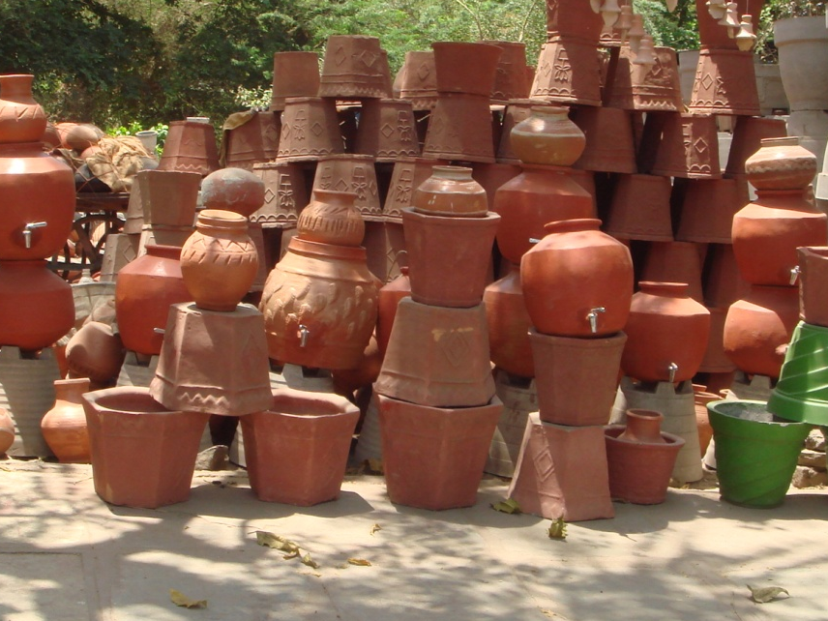
Mud to Structure

Slide 19
Mud to Structure
Before we start a new system, we collect requirement from customer → transform those into specifications
Requirements → Architecture (Optimistic View)
“Ball of mud” is the realization
Cutting the ball along only one aspect (like along lines visible in the application domain may not be of help)
Need to consider functional and non-funcational attributes

Slide 20
Architectural Patterns
Layers
Pipes and Filters
Blackboard
Mud to Structure
Broker
Distributed Systems
Model-View-Controller
Presentation-Abstraction-Control
Interactive Systems
Microkernel
Reflection
Adaptable Systems

Slide 21
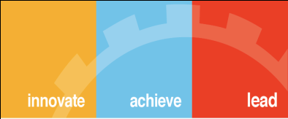
Thank You

